Slide 1

Operating System LAB 2
Linux overview and Shell Commands
Instructor
Saba Naseem
Saba.Naseem@nu.edu.pk
Notes:
1

Slide 2
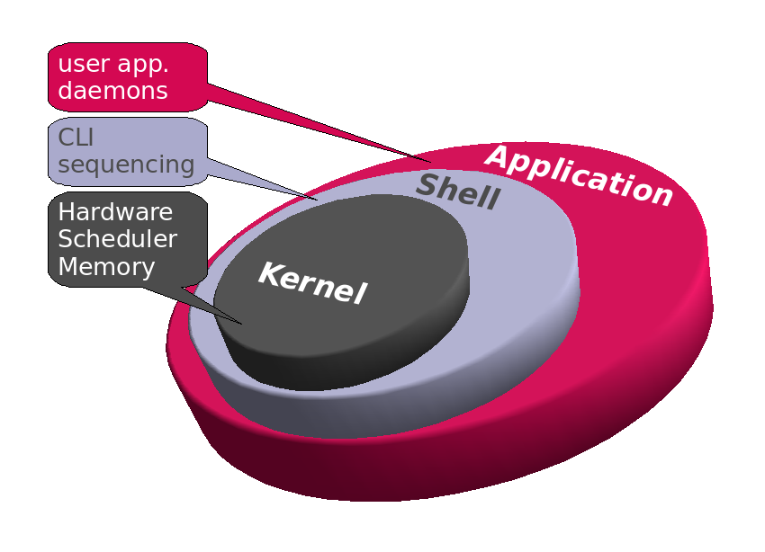
OVERVIEW OF UNIX/LINUX SYSTEM
Unix/Linux is operating system (OS).
Unix system is composed of kernel & shell.
Kernel & Shell
Both are parts of the OS
Kernel (interfacing with hardware) is a main program of Unix system. It controls hardware, CPU, memory, hard disk, network card etc.
Shell (command interpreter) is an interface between user and kernel. Shell interprets your input as commands and pass them to kernel.
Notes:
2
A Network interface card (also known as a NIC, network card, or network interface controller) is an electronic device that connects a computer to a computer network, usually a LAN. It is considered a piece of computer hardware.
Shell: the program that either process the command you enter in your terminal or process the shell scripts (text files).
The main difference between kernel and shell is that the kernel is the core of the operating system that controls all the tasks of the system while the shell is the interface that allows the users to communicate with the kernel.

Slide 3
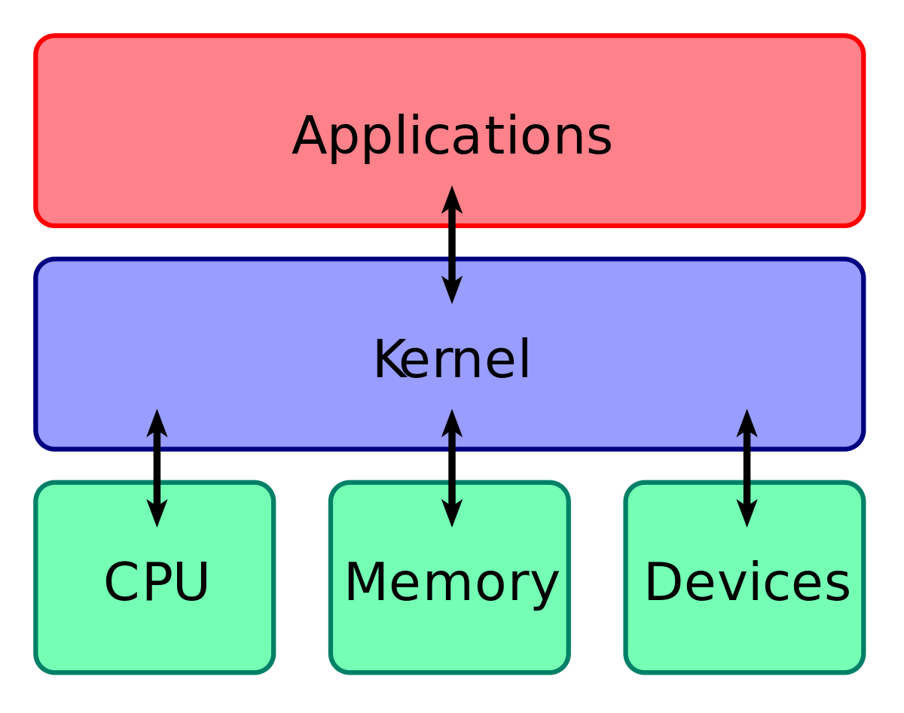
The Partition b/w Kernel and User Space

Slide 4
UNIX OVERVIEW (CONT.)‏
Directory Structure
Files are put in a directory.
All directories are in a hierarchical structure (tree structure).
User can put and remove any directories on their tree.
Top directory is “/”, which is called slash or root.
Users have their own directory. (home directory)‏

Slide 5
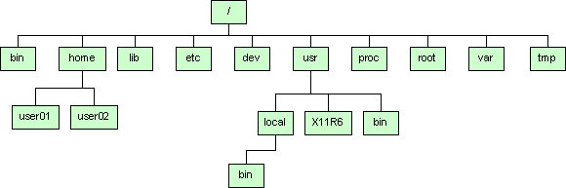
UNIX OVERVIEW (CONT.)‏
Directory Structure

Slide 6
How to Write and Compile a C++/C Code in Linux?

Slide 7
Code is same as we write in visual studio, has more specialized system calls to perform certain tasks.
First, create a .cpp file.
Write the “Hello World” program in it and save the file in home directory.
Go to Applications ->Accessories ->Terminal or simply press CTRL+ALT+T
Write g++ or gcc <File name>.cpp
Write ./a.out
Output??
Creating an executable file
To create any other executable file other than ./a.out
Use
g++ -o <Exec.file name > < Source file name>
./Exec.file name

Slide 8
UNIX OVERVIEW (CONT.)‏
Normal user and Super user
In Unix system, there is one special user account for administrator, which can do anything.
This special user is called root or superuser.
Case Sensitivity
Unix is case-sensitive.
MYFILE.doc, Myfile.doc, mYfiLe.Doc are different.
Online Manual
Unix has well-written online manuals.

Slide 9
BASIC COMMANDS
How to run commands
Search—Type Terminal
Press Ctrl+Alt+t to open Terminal
When you will open Terminal, you will see,
[someone]$
One command consists of three parts, i.e. command name, options, arguments.
Example)‏
[someone~]$ command-name optionA optionB argument1 argument2

Slide 10
BASIC COMMANDS
How to run commands
Between command name, options and arguments, space is necessary.
Options always start with “-”
Example:
cd ..
ls –l
mv fileA fileB

Slide 11
BASIC COMMANDS
File Handling Commands
cat: After concatenation Displays a File content
$cat filename
cp: Copy one or more files to another location
$cp < Source> <destination>
rm: Deletes a File
$rm <file name or path>
mv: move the file/files
$mv <source> <destination>
head: Displays the Beginning of a File
$ head -1 months
tail: Displays the End of a File
sort: Displays a File in Order
grep: Finds a String
Notes:
11
“ls” stands for list.
Pwd stands for present working directory

Slide 12
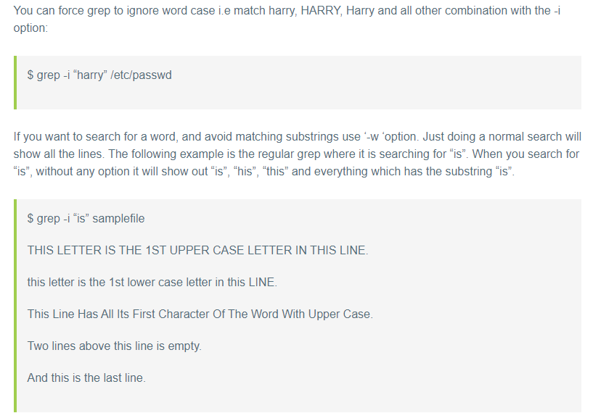

Slide 13
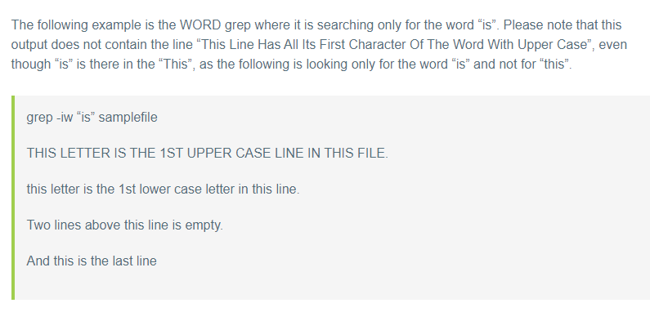

Slide 14
BASIC COMMANDS
Commands
ls show files in current position
cd change directory
cp copy file or directory
mv move file or directory
rm remove file or directory
pwd show current directory
mkdir create directory
rmdir remove directory
less, more, cat display file contents
man command read the online manual page for a command
whatis give brief description of a command
Notes:
14
“ls” stands for list.
Pwd stands for present working directory

Slide 15
BASIC COMMANDS
Commands
Who Display login name ,date , time and terminal
Whoami Display only the user name
Pwd Displays the path of the current working directory
Date Displays current time and date
Clear Clears the terminal screen
Echo Displays the message on screen
Exit Exit the Shell
Notes:
15
“ls” stands for list.
Pwd stands for present working directory

Slide 16
BASIC COMMANDS
Commands
su switch user
passwd change password
adduser create new user account
sudo adduser username
sudo su username (to check the created user)
userdel delete user account
df show disk space usage
shutdown reboot or turn off machine
sudo shutdown now
Notes:
16
“su” means switch user. When you have several user account on one machine.

Slide 17
Relative and Absolute path
Absolute path
Address from the root
/home/linux/
~/linux
Similar to:
FAST National University/ Chiniot-FSD Campus/ CS Department/ 2015 Batch/ Section A

Slide 18
Relative path
Relative to your current location
“.” your current location
“..” one directory above your current location
“pwd” (present working directory )gives you your current location of working directory
Example
ls ./linux : lists the content of the dir linux
ls ../../ : lists everything that is two dir higher
Similar to:
Go Left/turn right/take the TSOL/go

Slide 19
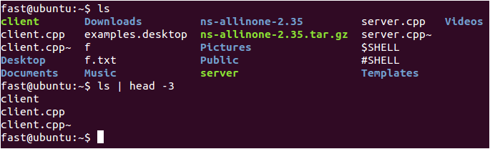
Redirect, append and pipe
Redirect and append
Output of command is displayed on screen.
Using “>”, you can redirect the output from screen to a file.
Using “>>” you can append the output at the end of the file.
Pipe
Some commands require input from a file or other commands (a mechanism for sending data from one program to another).
Using “|”, you can use output from other command as input to the command.
Notes:
Redirect == save

Slide 20
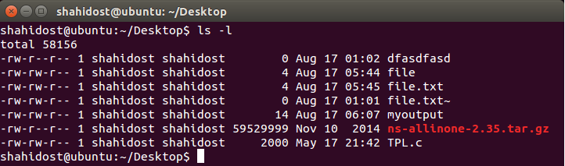
PERMISSION
All of files and directories have owner and permission.
There are three types of permission, readable, writeable and executable.
Permissions are given to three kinds of groups. owner, group member and others.
r→readable, w→writable, x→executable
Example:
Notes:
20

Slide 21
Example:
In the above example the first 10 characters of the output are what we look at to identify permissions.
The first character identifies the file type. If it is a dash ( - ) then it is a normal file. If it is a d then it is a directory.
The following 3 characters represent the permissions for the owner.
A letter represents the presence of a permission and a dash ( - ) represents the absence of a permission. In this example the first file owner has all permissions (read, write but not execute).
The following 3 characters represent the permissions for the group. In this example the group has the ability to read but not write or execute.
Note that the order of permissions is always read, then write then execute.
Finally the last 3 characters represent the permissions for others (or everyone else). In this example they have the read permission and nothing else.
Notes:
21

Slide 22
PERMISSION
Command
chmod change file mode, add or remove permission
chown change owner of the file
Example)‏
chmod a+w filename
add writable permission to all users
chmod o-x filename
remove executable permission from others
chmod a+x
Gives permission to the user to execute a file
u→user (owner), g→group, o→others a→all

Slide 23
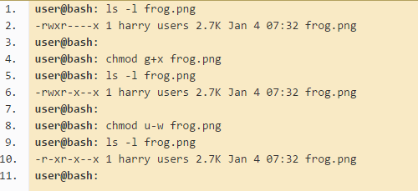
PERMISSION
Grant the execute permission to the group.
Then remove the write permission for the owner.

Slide 24
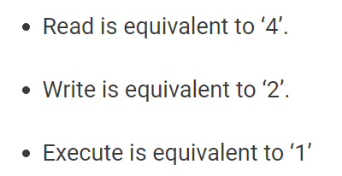

Slide 25
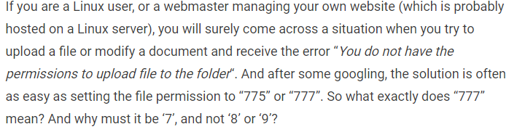

Slide 26
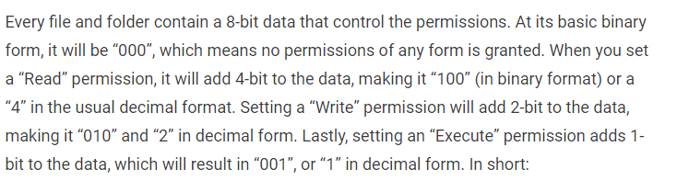

Slide 27
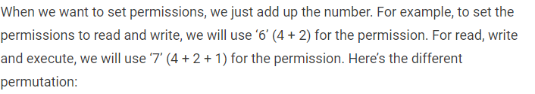

Slide 28
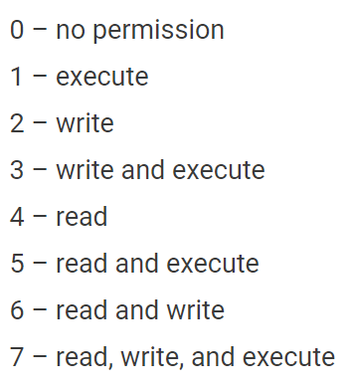
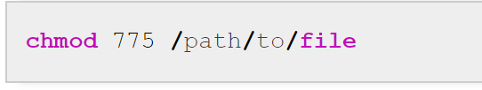

Slide 29
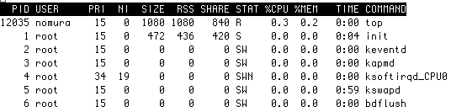
PROCESS MANAGEMENT
Process is a unit of running program.
Each process has some information, like process ID, owner, priority, etc.
Example) Output of “top” command

Slide 30
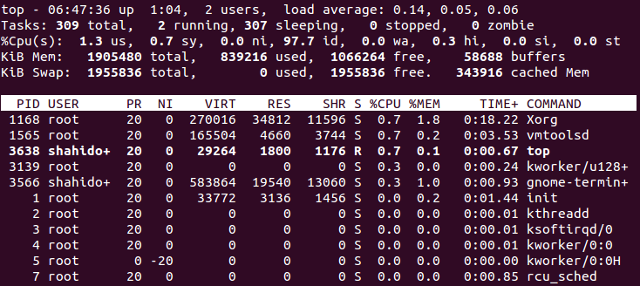
PROCESS MANAGEMENT
Line 1-2 Tasks is just another name for processes. It's typical to have quite a few processes running on your system at any given time. Most of them will be system processes. Many of them will typically be sleeping. This is ok. It just means they are waiting until a particular event occurs, which they will then act upon.
Notes:
30
These are commands related with process management. Kill is used to stop your program.

Slide 31
PROCESS MANAGEMENT
Line 3 CPU information.
Line 4 This is a breakdown of working memory (RAM). Don't worry if a large amount of your memory is used. Linux keeps recently used programs in memory to speed up performance if they are run again. If another process needs that memory, they can easily be cleared to accommodate this.
Line 5 This is a breakdown of Virtual memory on your system. If a large amount of this is in use, you may want to consider increasing it's size. For most people with most modern systems having gigabytes of RAM you shouldn't experience any issues here.
Lines 6 - --- Finally is a listing of the most resource intensive processes
Notes:
31
These are commands related with process management. Kill is used to stop your program.

Slide 32
PROCESS MANAGEMENT
Commands
kill Stops a program. The program is specified by process ID.
killall Stops a program. The program is specified by name.
ps Shows process status
top Shows system usage statistics
Notes:
32
These are commands related with process management. Kill is used to stop your program.

Slide 33
Exercise
Practice all the commands given in this presentation(slide 11,12, 13,14, 21, 25,27).
Make a Word File and copy the commands and a short description of the commands which you have learnt.
Submit it on Google Classroom.
https://linoxide.com/linux-command/essential-linux-basic-commands/
https://linoxide.com/linux-how-to/linux-commands-brief-outline-examples/
https://www.maketecheasier.com/file-permissions-what-does-chmod-777-means/

